Slide 1









DASHBOARD
BANKING CLIENT INSIGHTS
Team Code : DS007
Members : Adarsh Prakash Singh
Dakshita
Ayushmaan Singh

Slide 2





Slides Overview
01
Dashboard
02
Dataset
07
Customer Record Table
03
Extract, Transform, Load
08
Customers by Loyalty Categories
04
Measures Added
09
Customers by Risk Weightage
05
Key Performance Indicators
10
Deposits and Loans by Occupation
06
Filters
11
Questions Addressed

Slide 3

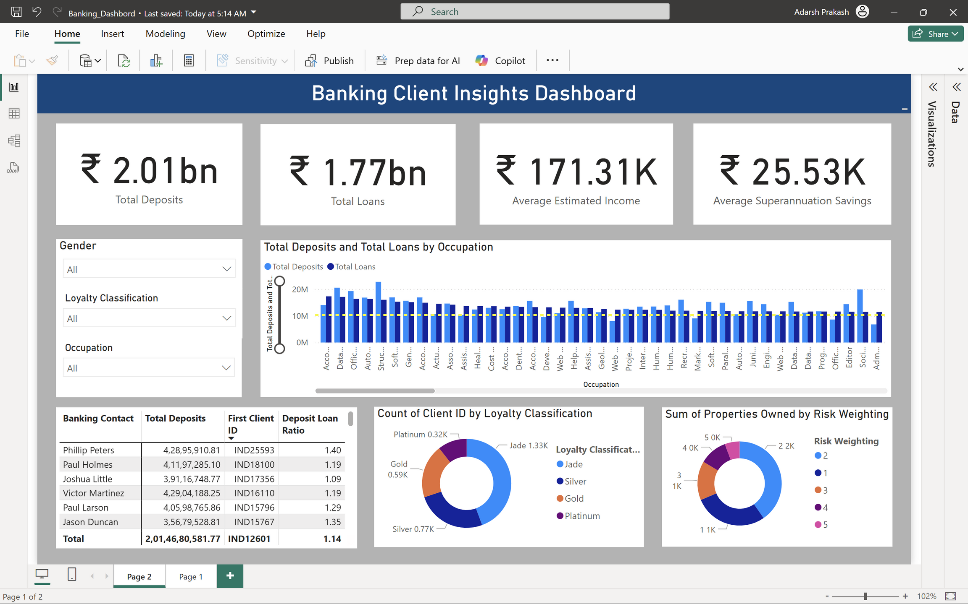




Dashboard
Created in

Slide 4


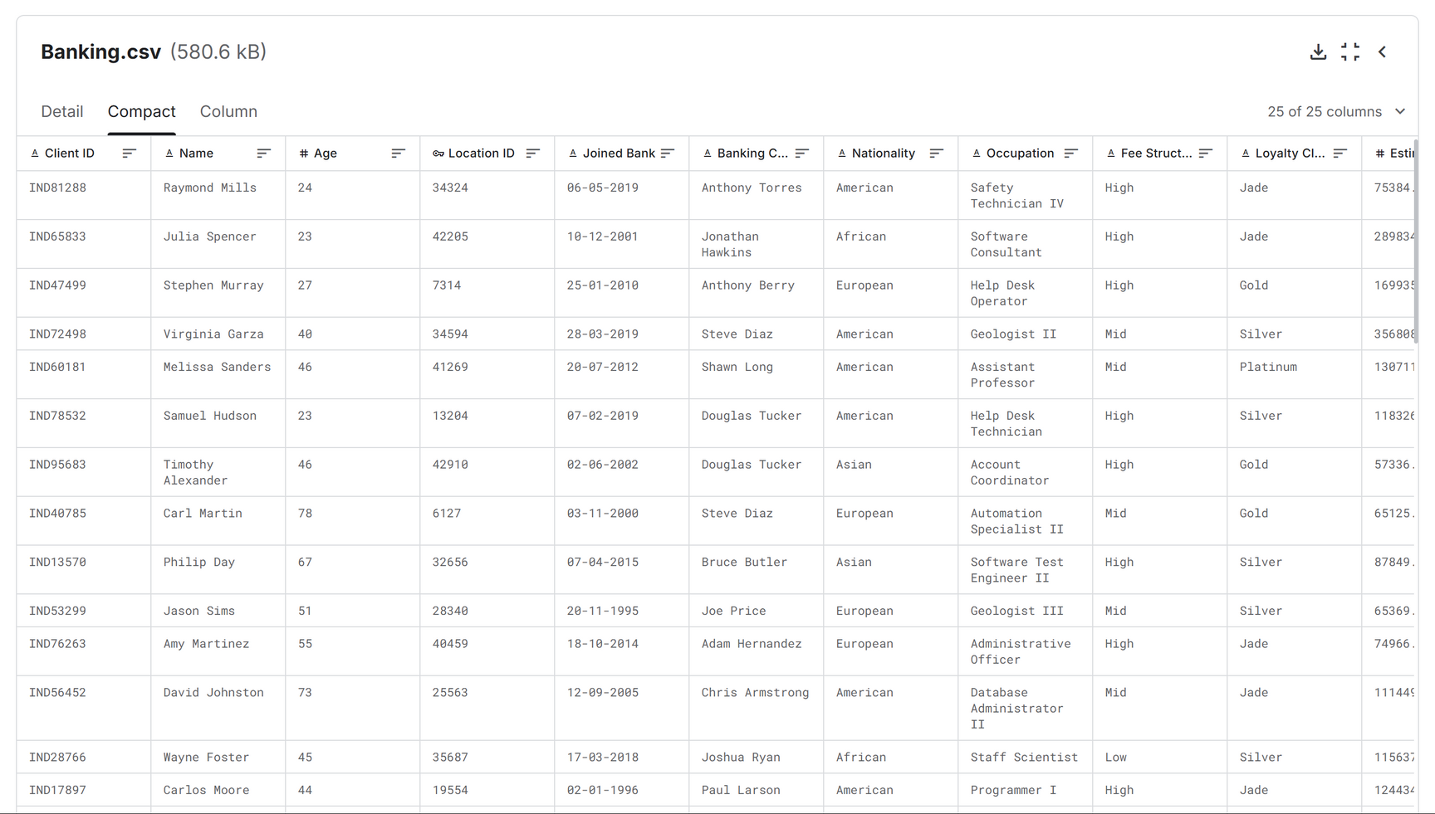


Dataset
Dataset downloaded from

Slide 5


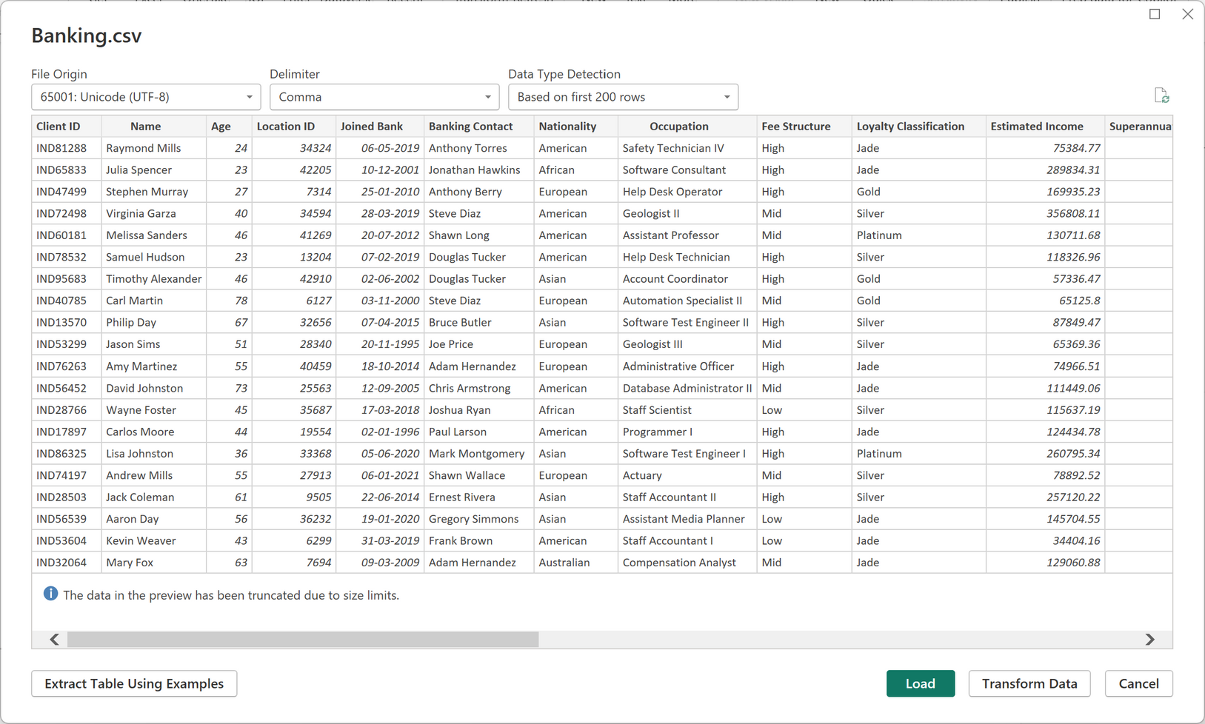


Extract, Transform, Load
Performed ETL
Extracted the CSV file
Dataset was found clean
No null or inconsistent data types
Changed format of joined bank column for effective calculation
Loaded the dataset in the Model View

Slide 6

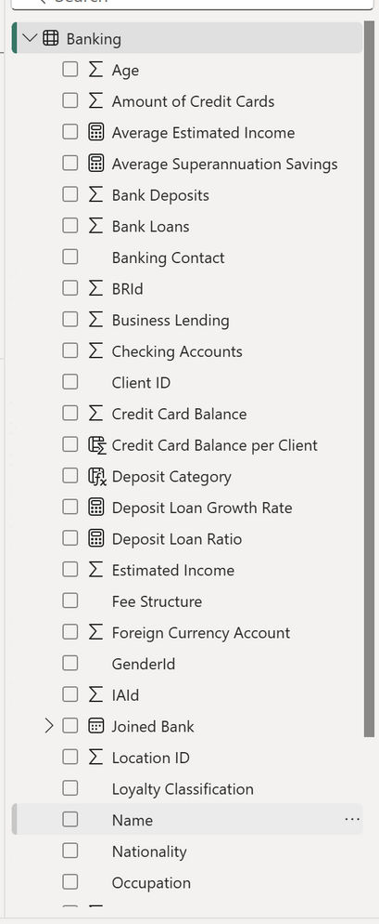

Measures Added
Added 6 New Measures in the dataset to make the analysis and visualisation effective
Average Estimated Income = AVERAGE(Banking[Estimated Income])
Average Superannuation Savings = AVERAGE(Banking[Superannuation Savings])
Deposit Loan Growth Rate = DIVIDE([Total Deposits],[Total Loans])
Deposit Loan Ratio = DIVIDE(SUM(Banking[Bank Deposits]),
SUM(Banking[Bank Loans]))
Total Deposits = SUM(Banking[Bank Deposits])
Total Loans = SUM(Banking[Bank Loans])

Slide 7

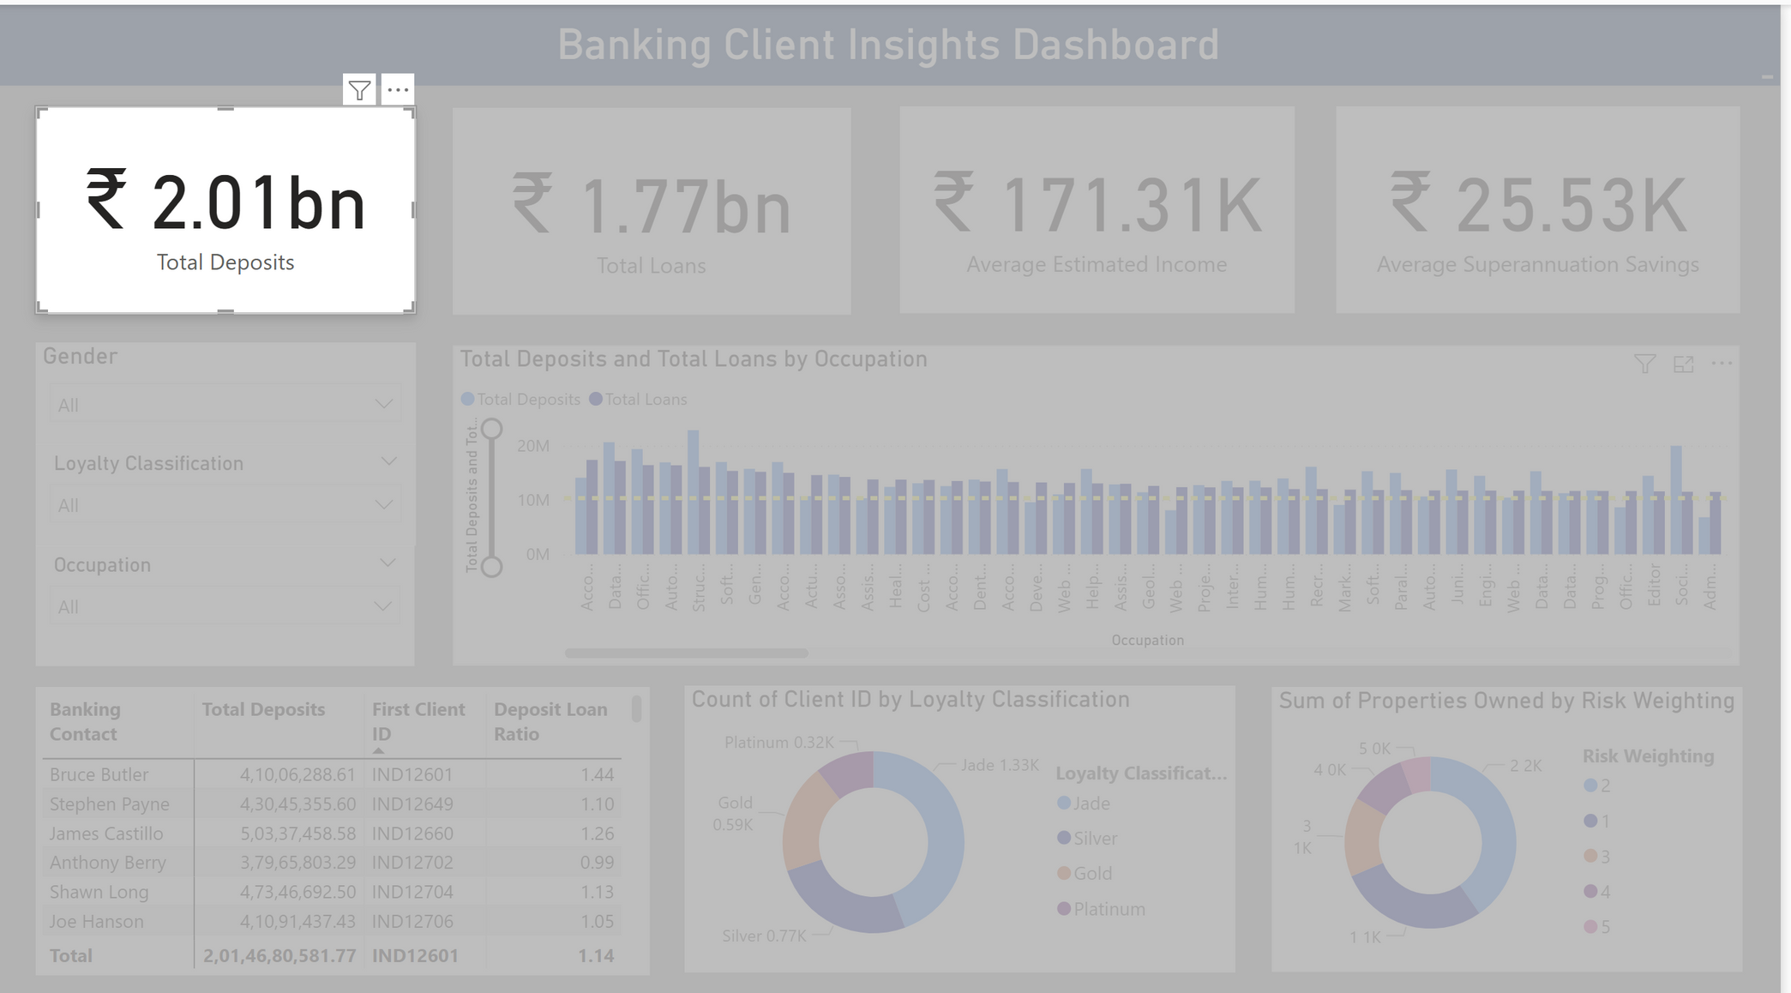
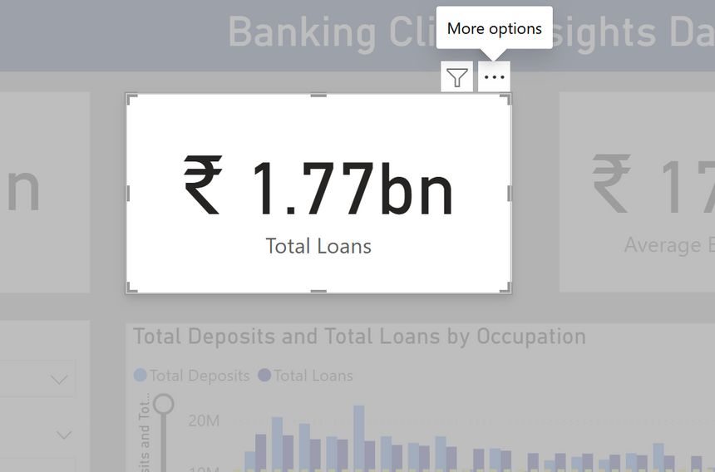


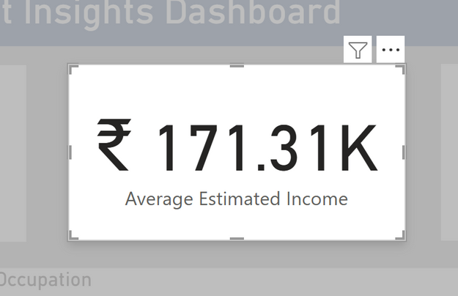
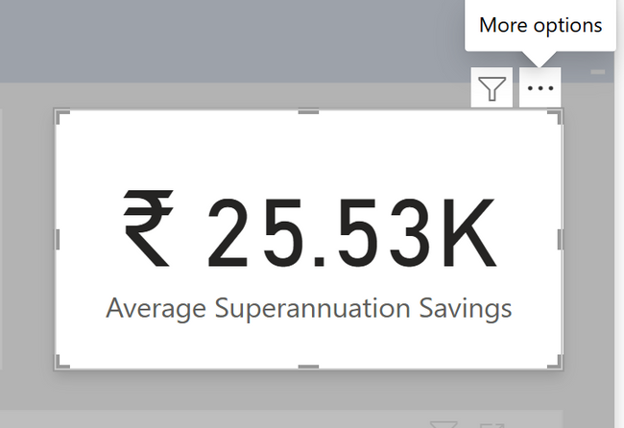
Key Performance Indicators
Represents the total funds held by customers across all deposit accounts, reflecting overall liquidity strength.
Represents the total funds held by customers across all deposit accounts, reflecting overall liquidity strength.
Represents the total funds held by customers across all deposit accounts, reflecting overall liquidity strength.
Represents the total funds held by customers across all deposit accounts, reflecting overall liquidity strength.

Slide 8


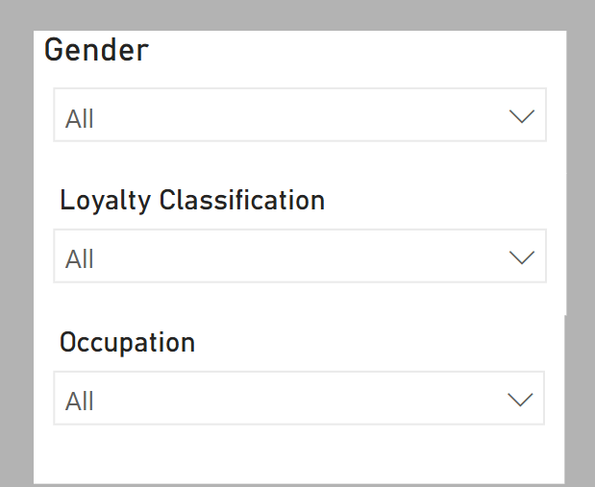


Filters
Gender Filter: Enables demographic-based insights by segmenting data by gender.
Loyalty Classification Filter: Helps identify patterns and trends among varying loyalty levels.
Occupation Filter: Allows analysis tailored to professional backgrounds for deeper client understanding.

Slide 9

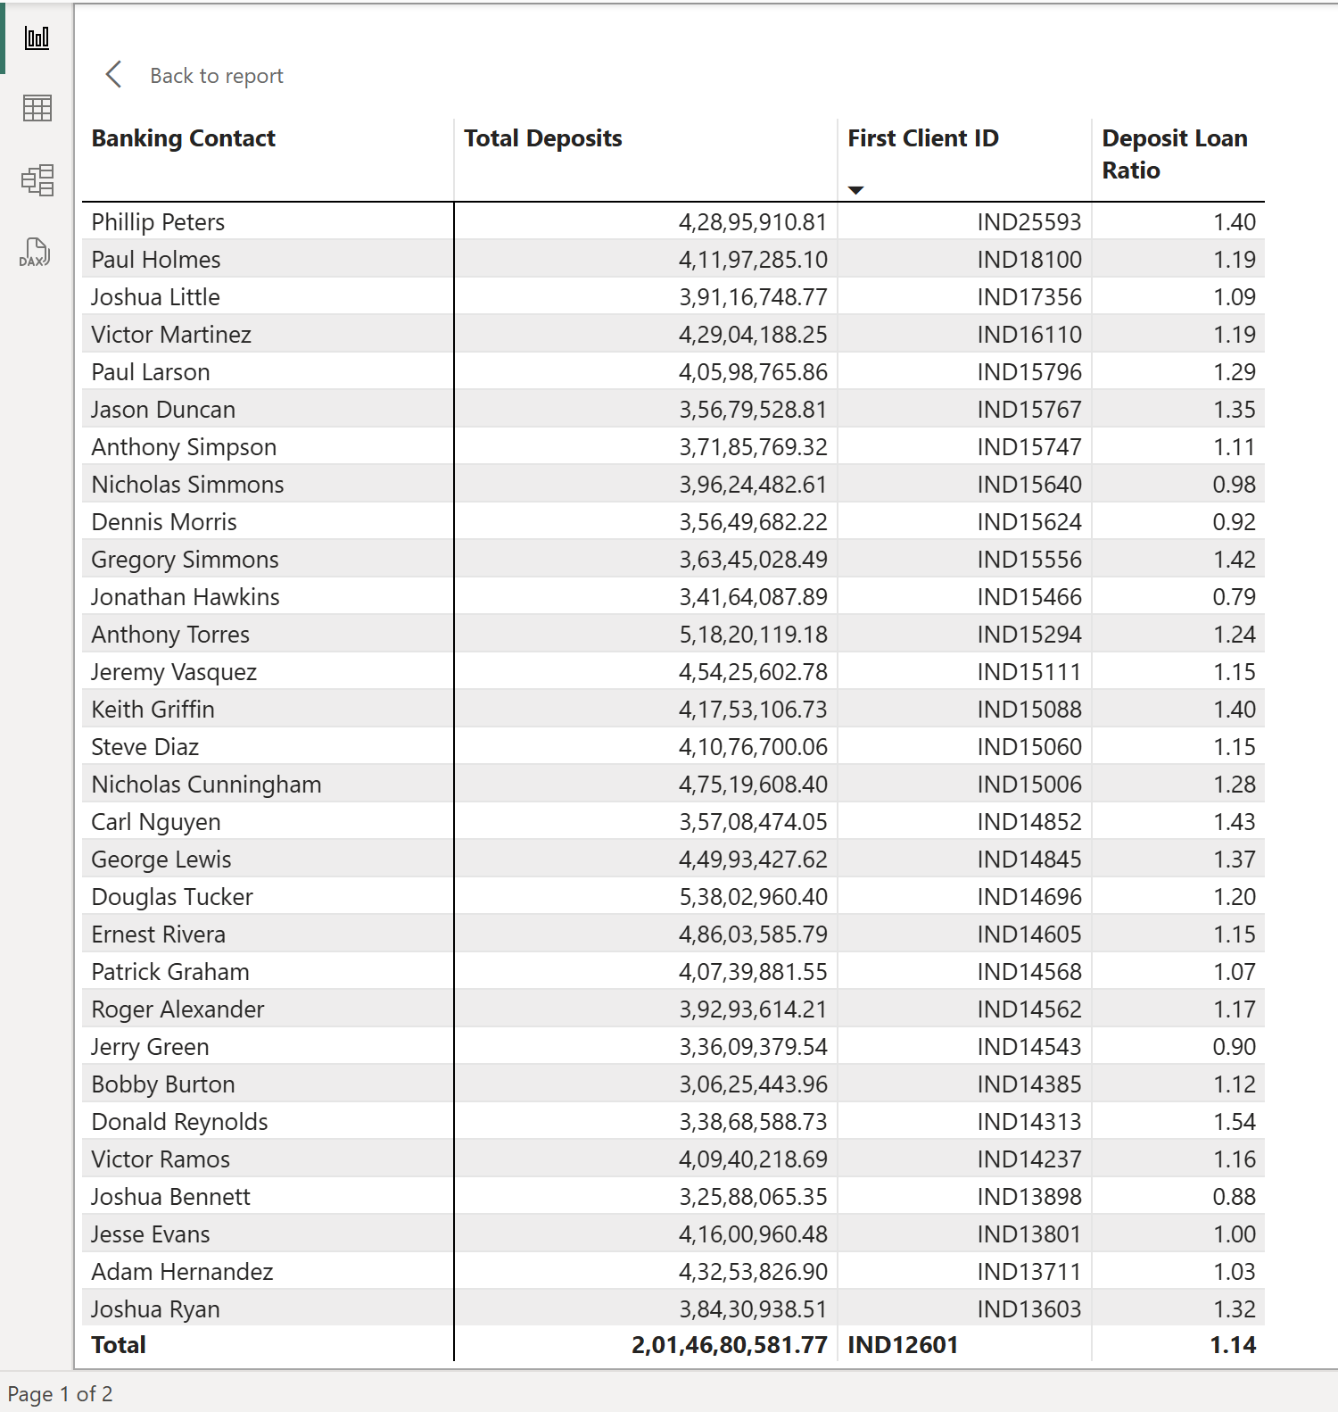
Customer Record Table
Insights:
Clients like Phillip Peters and Paul Holmes show high deposit volumes.
Most customers maintain balanced deposit-loan ratios, with some outliers.
These patterns help assess client value and guide targeted financial planning.

Slide 10
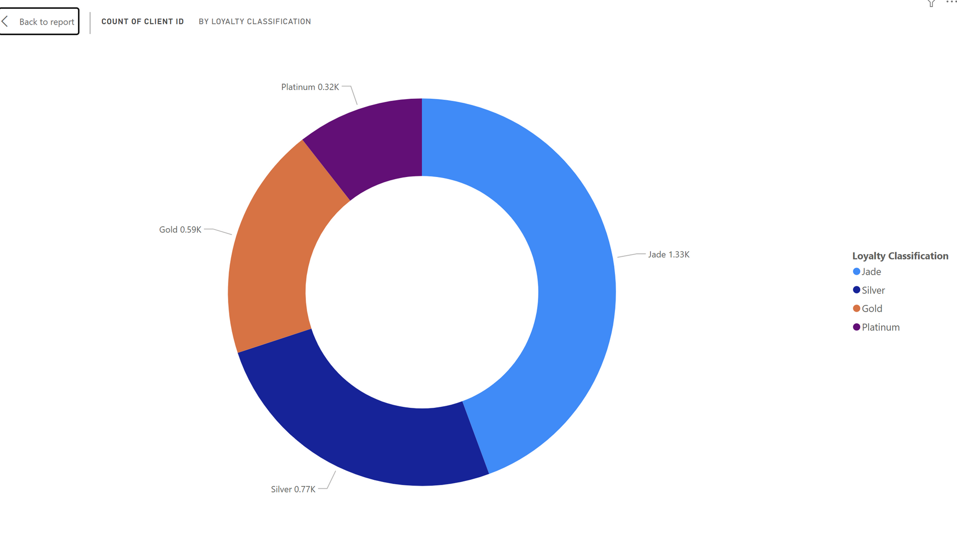

Customers by Loyalty Categories
Insights :
The majority of customers fall into the Jade and Silver tiers.
Platinum and Gold segments are relatively small, indicating limited top-tier loyalty.
This suggests a need to enhance engagement strategies for higher loyalty conversion.

Slide 11
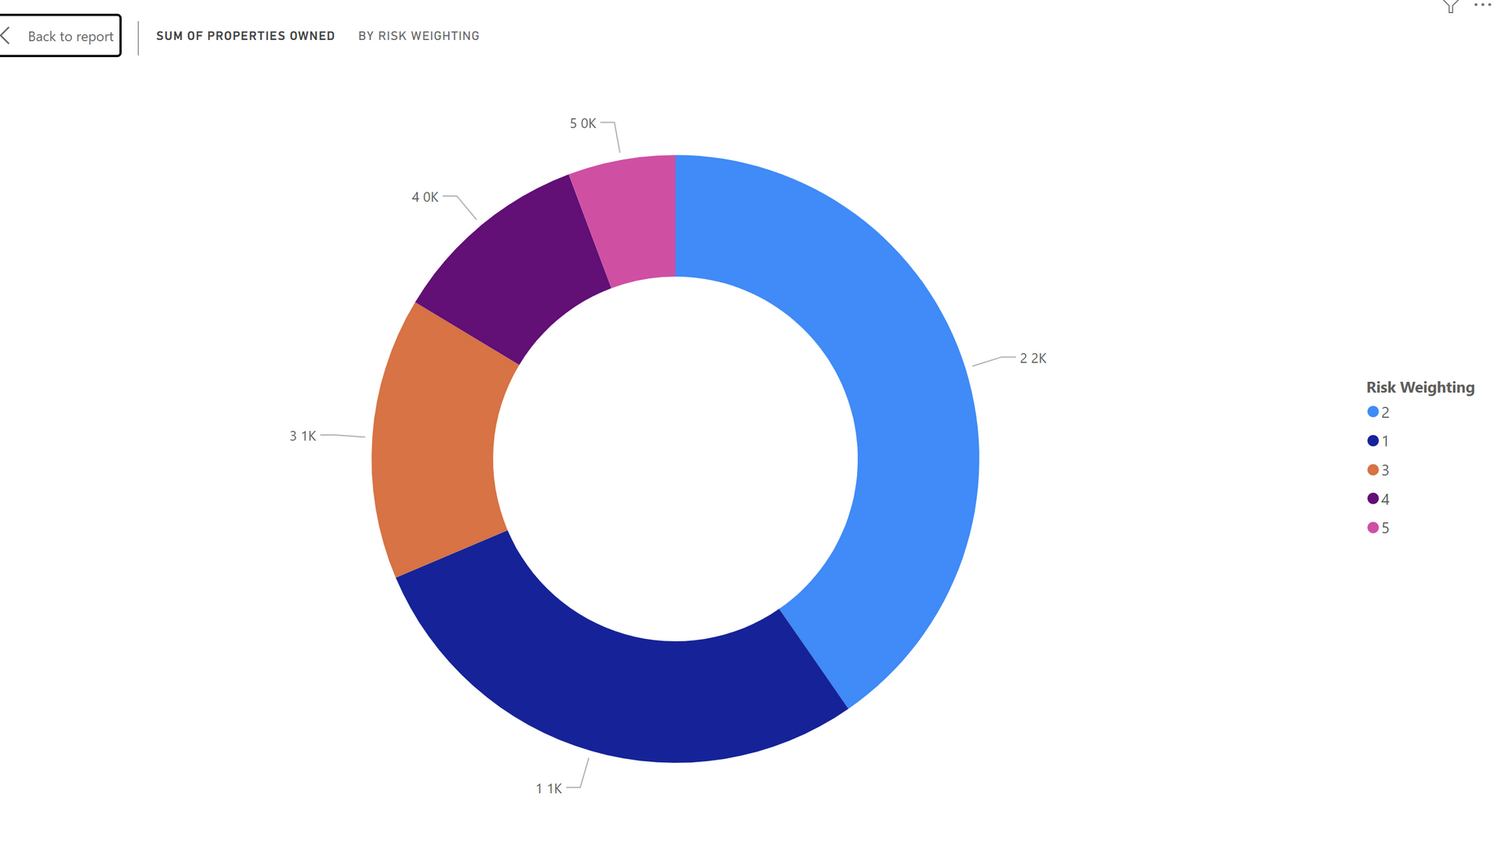
Customers by Risk Weightage
Insight:
The majority of customers fall under lower risk categories, with the highest number in Risk Weighting 2. As the risk level increases from 2 to 5, the number of properties owned by customers decreases significantly. This suggests a cautious investment approach among higher-risk profiles and potentially stronger engagement or trust among low-risk customers.

Slide 12
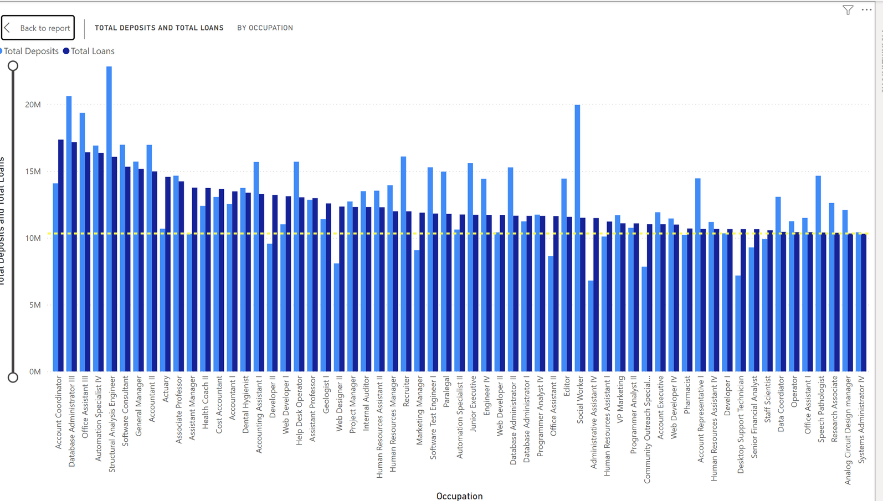
Deposits and Loans by Occupation
Insight:
A clear occupational trend emerges in total deposits and loan amounts. Professions like engineers, and IT professionals show higher deposit volumes, while business owners exhibit higher loan usage. This implies that financial products and marketing strategies could be optimized by targeting occupations with high financial activity, customizing offerings to suit their typical banking behavior.

Slide 13
Business Problems / Questions Addressed
In this report, we’re diving into client insights to help the bank make smarter, data-driven decisions. Here’s what we’re looking to find out:
How are our customers spread across different loyalty categories?
→ This helps us see how engaged our clients are and where we might need to work on boosting loyalty.
2.What’s the risk profile of our customers, and how does it connect to their property ownership?
→ By understanding this, we can offer better financial advice and products that fit their comfort with risk.
3.Which occupations are bringing in the most deposits and taking out the most loans?
→ Spotting these trends lets us fine-tune our marketing and financial products for different professional groups.
4.What do our key financial numbers look like — like average income, total deposits, and deposit-loan ratios?
→ These KPIs help us track overall financial performance and customer activity.
5.Who are our high-value clients based on their deposits and deposit-loan ratios?
→ Identifying them means we can offer premium services and personalized financial solutions to the right people.
6.How do factors like gender, occupation, and loyalty level affect banking behavior?
→ This insight allows us to design more personalized, targeted campaigns and services for different customer segments

Slide 14

Thank you!

